Slide 1
Capstone Project
Final Presentation: battle of the neighborhoods

Slide 2
PROBLEM
Where can we put the first Papa Pete’s Pizza in Toronto, Canada?
Stakeholders: Our investor’s as well as family member’s who have a stake in the company
Specifically, the goal is to locate the best neighborhood(s) to open the first Papa Pete’s Pizza in Toronto in an area that is not overcrowded with pizza shops currently.

Slide 3
Data
https://en.wikipedia.org/wiki/List_of_postal_codes_of_Canada:_M which will provide a list of neighborhoods in Toronto.
As with previous projects throughout the course we will be utilizing:
Python requests
Beautiful Soup
Geocoder
Web scraping, data cleaning/wrangling, clustering, mapping and the Foursquare API

Slide 4
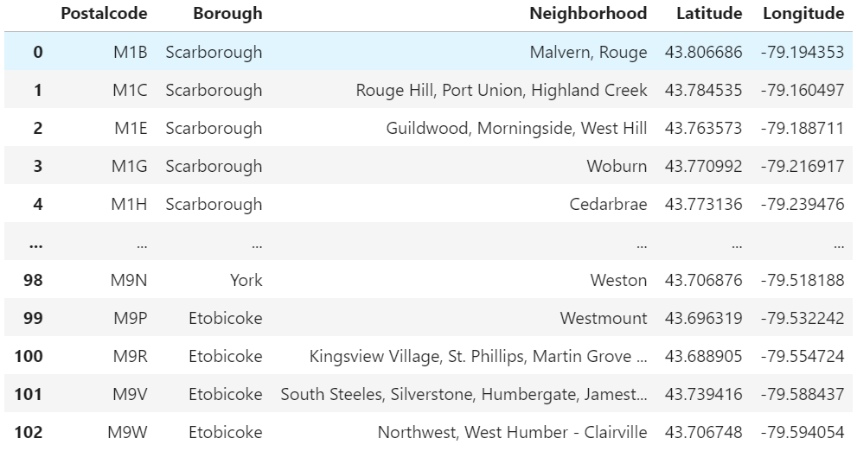
Dataframe
To the right is a snip of the table that has been built with the latitude and longitude

Slide 5
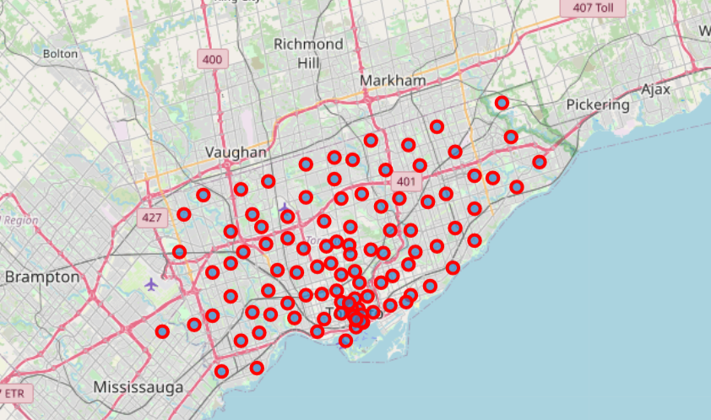
Map
To the right is a map of Toronto we have created using Folium

Slide 6
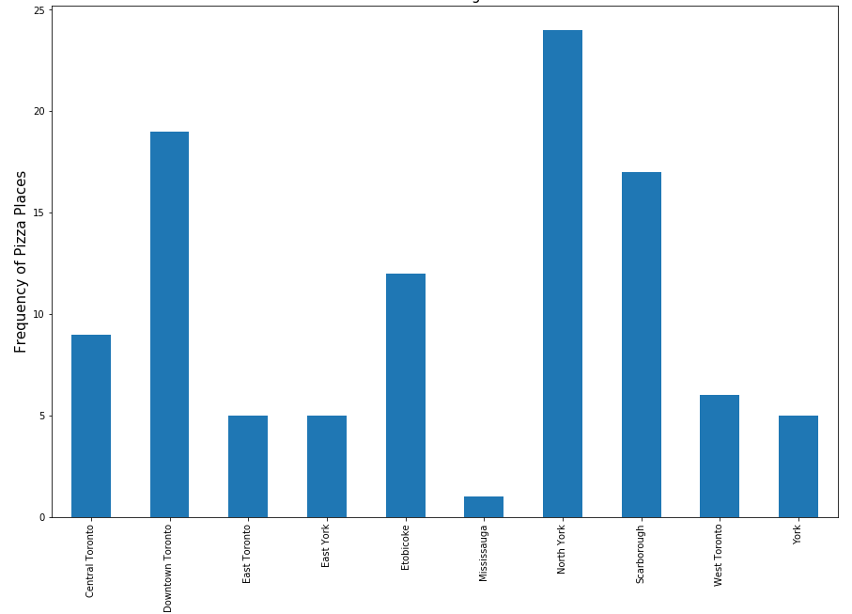
Graph of Pizza Places
To the right is a graph showcasing the number of pizza places in each borough

Slide 7
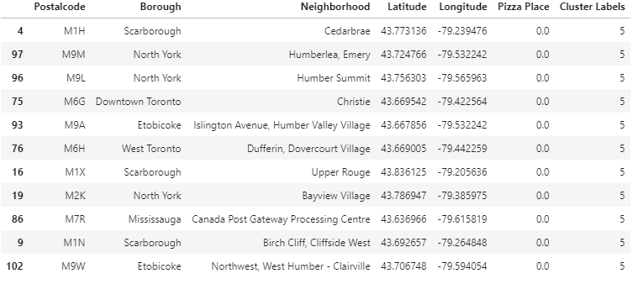
Findings
Based on the findings the pizza shop should be placed in Cluster Five (seen to the right). There are currently no pizza shops in these areas.

